Slide 1
Image Quality Comparison in selected regions
Sarah Mccarty

Slide 2

Mask image

Slide 3
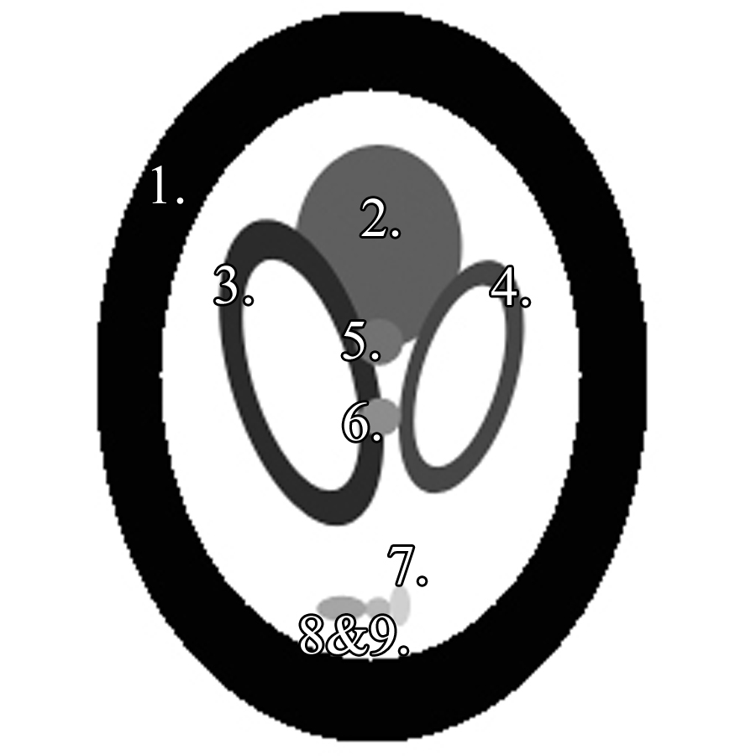
Mask prep

Slide 4
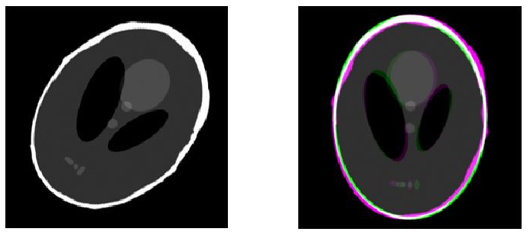
Image registration

Slide 5

Image comparison

Slide 6






Test image creation

Slide 7
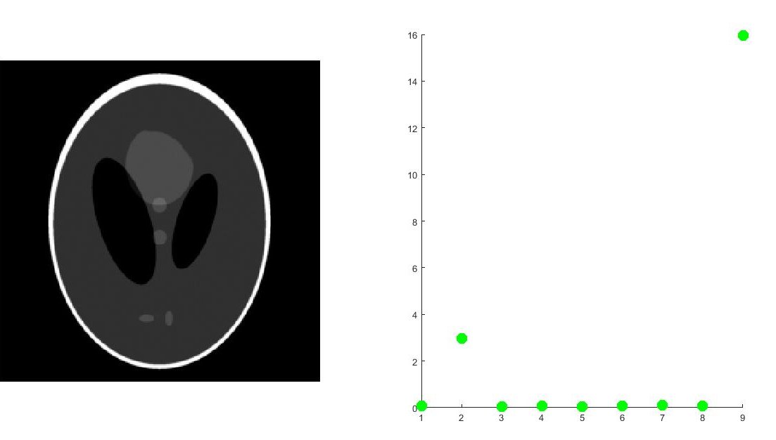
Test results

Slide 8
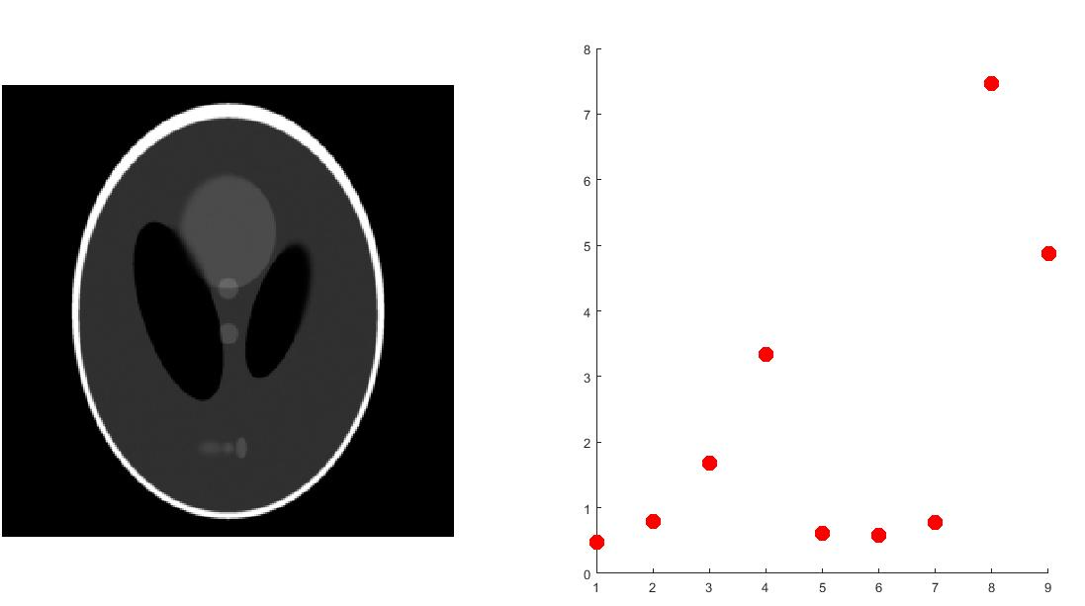
Test results

Slide 9
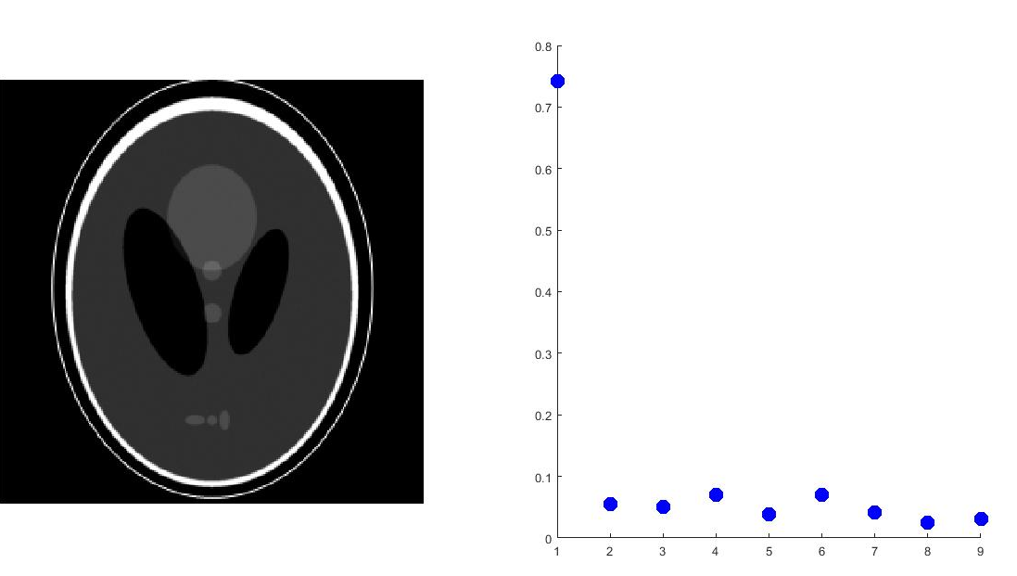
Test results

Slide 10
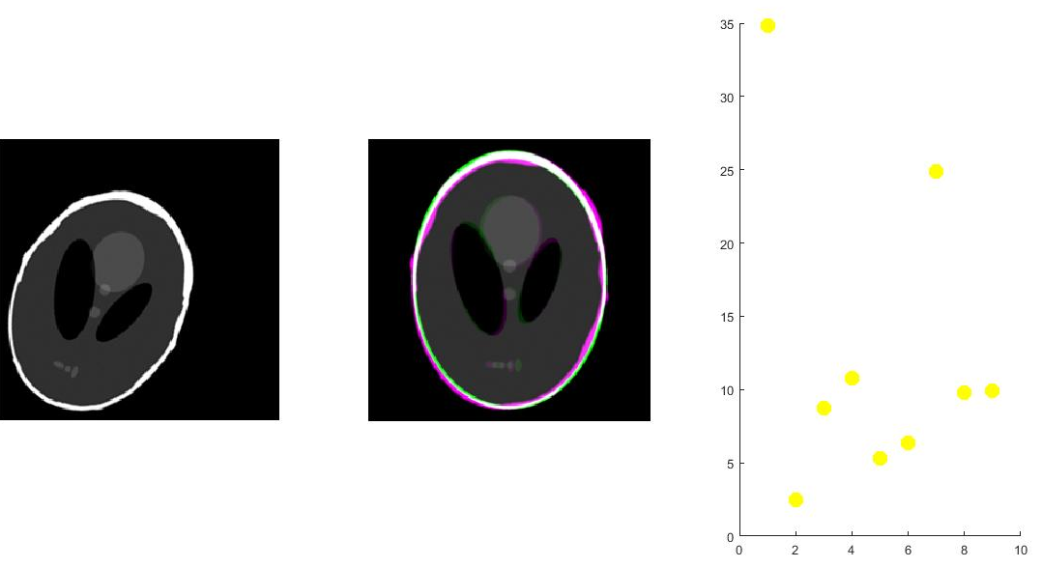
Image registration testing

Slide 11
Questions?
Image quality comparison in selected regions

